Slide 1
Antimycobacterial Drugs

Slide 2
Tuberculosis (TB) is an infectious disease caused by the bacterium Mycobacterium tuberculosis (MTB).
Tuberculosis generally affects the lungs.
Most infections do not have symptoms; in which case it is known as latent tuberculosis.
10% of latent infections progress to active disease which, if left untreated, kills about half of those infected.
The classic symptoms of active TB are a chronic cough with blood-containing sputum, fever, night sweats, and weight loss..

Slide 4
Mycobacteria are resistant to most antibiotics because:
they grow more slowly than other bacteria.
Mycobacterial cells can also be dormant and thus completely resistant to many drugs.
mycobacterial cell wall is impermeable to many agents.
Mycobacterial species are intracellular pathogens
mycobacteria are notorious for their ability to develop resistance.

Slide 5
So T.B treatment characterized by:
two or more drugs are required to overcome these obstacles and to prevent emergence of resistance during the course of therapy.
The response of mycobacterial infections to chemotherapy is slow, and treatment must be administered for months to years.

Slide 6
TB treatment generally includes:
first-line drugs: Rifampin, Isoniazid , Ethambutol, , Pyrazinamide.
2. Second-line drugs: include an aminoglycoside (streptomycin, kanamycin, or amikacin) or capreomycin (all injectable agents), a fluoroquinolone (typically levofloxacin or moxifloxacin).
are typically less effective, more toxic.
less extensively studied. They are used for patients who cannot tolerate the first-line drugs or who are infected with resistant TB.

Slide 7
A. Isoniazid (INH)
Isoniazid along with rifampin, is one of the two most important TB drugs.
1. Mechanism of action:
Isoniazid is a prodrug activated by a mycobacterial catalase–peroxidase (KatG).
Isoniazid targets the enzymes acyl carrier protein reductase (InhA) and β-ketoacyl-ACP synthase (KasA), essential for the synthesis of mycolic acid.
Inhibiting mycolic acid leads to a disruption in the bacterial cell wall.

Slide 8
2. Pharmacokinetics
Isoniazid is readily absorbed after oral administration. Absorption is impaired if isoniazid is taken with food.
The drug diffuses into all body fluids, cells, and caseous material (necrotic tissue resembling cheese that is produced in tuberculous lesions).
Isoniazid undergoes N-acetylation and hydrolysis, resulting in inactive products.

Slide 9
3. Adverse effects:
Hepatitis is the most serious adverse effect, it can be fatal.
Peripheral neuropathy (manifesting as paresthesia of the hands and feet) appears to be due to a relative pyridoxine deficiency.
Central nervous system (CNS) adverse effects can occur, including convulsions in patients prone to seizures.

Slide 10
B. Rifamycins: rifampin, rifabutin, and rifapentine
Rifampin, rifabutin, and rifapentine are all considered rifamycins, a group of structurally similar macrocyclic antibiotics, which are first-line oral agents for tuberculosis.

Slide 11
Rifampin
Rifampin has broader antimicrobial activity than isoniazid and can be used as part of treatment for several different bacterial infections.
It is never given as a single agent in the treatment of active tuberculosis.

Slide 12
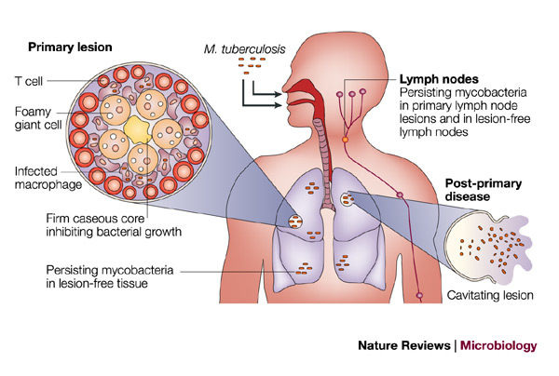

Slide 13
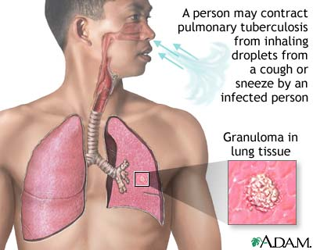

Slide 14
Mechanism of action
Rifampin blocks RNA transcription by interacting with the β subunit of mycobacterial DNA-dependent RNA polymerase.

Slide 15
Rifampin Antimicrobial spectrum
bactericidal for both intracellular and extracellular mycobacteria, including M. tuberculosis.
It is effective against many gram-positive and gram-negative organisms and is used prophylactically for individuals exposed to meningitis caused by meningococci or Haemophilus influenzae.
Rifampin also is highly active against M. leprae.

Slide 16
d. Rifampin Pharmacokinetics
Absorption is adequate after oral administration.
Distribution occurs to all body fluids and organs.
induce hepatic cytochrome P450 enzymes leading to numerous drug interactions.
Elimination is primarily through the bile and into the feces.
Urine, feces, and other secretions have an orange-red color, so patients should be forewarned.

Slide 17
Rifampin Adverse effects
The most common adverse reactions include nausea, vomiting, and rash.
Hepatitis and death due to liver failure are rare.
the incidence of hepatic dysfunction increase when rifampin is coadministered with isoniazid. When rifampin is dosed intermittently, especially.

Slide 18
D. Pyrazinamide
Pyrazinamide used in combination with isoniazid, rifampin, and ethambutol.
The precise mechanism of action is unclear.
Pyrazinamide is active against tuberculosis bacilli in acidic lesions and in macrophages.
The drug distributes throughout the body, penetrating the CSF.
Pyrazinamide may contribute to liver toxicity. Most of the clinical benefit from pyrazinamide occurs early in treatment. Therefore, this drug is usually discontinued after 2 months of a 6-month regimen.

Slide 19
E. Ethambutol
Ethambutol is bacteriostatic and specific for mycobacteria. Ethambutol inhibits arabinosyl transferase—an enzyme important for the synthesis of the mycobacterial cell wall.
Ethambutol is used in combination with pyrazinamide, isoniazid, and rifampin pending culture and susceptibility data.
Ethambutol is well distributed throughout the body. Both the parent drug and metabolites are primarily excreted in the urine. The most

Slide 20
important adverse effect is optic neuritis, which results in diminished visual acuity and loss of ability to discriminate between red and green. Visual acuity and color discrimination should be tested prior to initiating therapy and periodically thereafter.

